Slide 1
Final project.
Fake news recognition.
Done by: Azimkhanov Bauyrzhan
Kystaubayev Yernur
Almasbekuly Orken

Slide 2
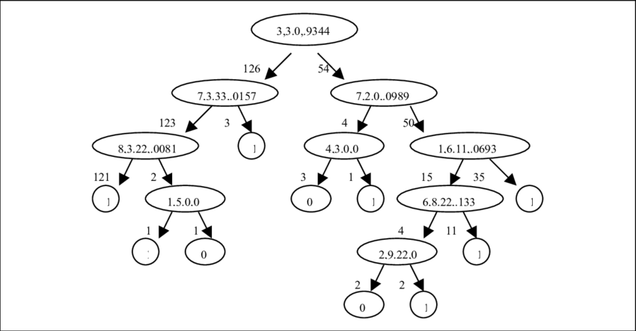
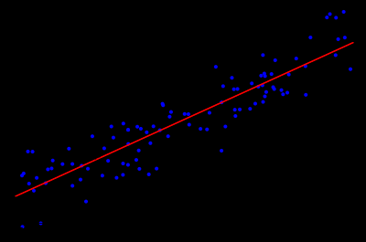
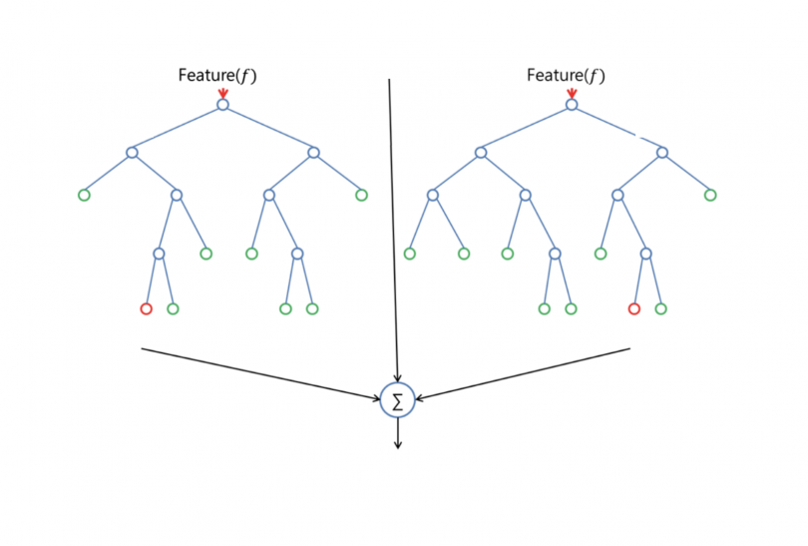
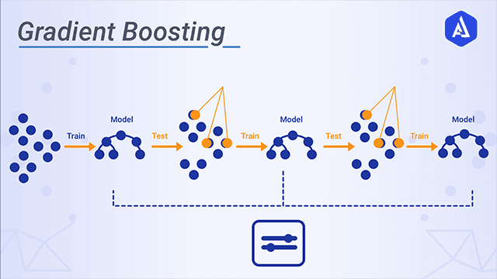
Our models
Decision tree Linear regression Random forest classifier Gradient Boosting

Slide 3
Summary of models accuracy
 | LR | DT | GBC | RFC
Political | 4/5=80% | 3/5=60% | 3/5= 60% | 4/5= 80% | 70%
Weather | 3/6=50% | 4/6=66.6% | 3/6 = 50% | 4/6 = 66.6% | 58.3%
Sport | 4/7=57.1% | 3/7=42.8% | 3/7 = 42.8% | 7/7 = 100% | 60.6%
Prediction | 3/6=50% | 4/6=66.6% | 4/6 = 66.6% | 3/6 = 50% | 58.3%
Culture | 3/5=60% | 3/5=60% | 2/5 = 40% | 2/6 = 33.3% | 48.2%
Random topic | 2/6=33.3% | 3/6=50% | 3/3 = 50% | 6/6 = 100% | 58.32%
COVID SARS-2 | 2/4=50% | 2/4=50% | 2/4 = 50% | 2/4 = 50% | 50%
Total | 61.48% | 56.57% | 51.34% | 68.55%

Slide 4
Our Analysis
In this paper, we have performed a comparative analysis of 4 different algorithms.
And they revealed the following patterns:
1. All algorithms did a poor job of analyzing sports and culture news.
2. Algorithms do not respond well to short texts.
3. Algorithms poorly process texts with a large number of technical and other narrow-profile terms.
Causes of errors.
The main and most important reason for errors is the dataset.
Our dataset is composed of verified articles from the British Reuters. But it contains over 23,000 entries, most of which cover political and world news.
The second reason for errors is the properties and parameters of these algorithms. They are too simple for more accurate error detection. Usually, recurrent neural networks and neural networks with long-term memory are used for these purposes. Such networks have additional axons for memorizing the empty states of the vector.

Slide 5
COVID SARS-2
We have applied our models to various news coverage of the coronavirus epidemic. On average, all algorithms produced the same answers.

Slide 6
COVID SARS-2
Wikipedia | LR Prediction: Fake News DT Prediction: Fake News GBC Prediction: Fake News RFC Prediction: Fake News
CNN | LR Prediction: Fake News DT Prediction: Fake News GBC Prediction: Fake News RFC Prediction: Fake News
RT | LR Prediction: Fake News DT Prediction: Fake News GBC Prediction: Fake News RFC Prediction: Fake News
Twitter | LR Prediction: Fake News DT Prediction: Fake News GBC Prediction: Fake News RFC Prediction: Fake News

Slide 7
Confusion Matrix
 | PREDICTED TRUE | PREDICTED FALSE
ACTUAL TRUE | 5, 4, 1, 7 | 15, 16, 19, 13 | 20,20,20,20
ACTUAL FALSE | 5, 2, 0, 3 | 14, 17, 19, 16 | 19,19,19,19
 | 10, 6, 1, 10 | 29, 33, 38, 29

Slide 8
Our recommendations
Ways to improve models:
1. Take a more diverse dataset and include more news categories in it.
2. For each specific algorithm, increase the "computing power". For RFCs and DTs, increase the number of trees. For GBC and LR use different activation functions.

Slide 9
Links
https://drive.google.com/drive/folders/1sSHUVl6U2KUDeyrd3R9gsYNYB711eMWG?usp=sharing
https://github.com/BauyrzhanAzimkhanov/Machine-learning

